Slide 1
Career Assistant Program
(Sprint 2)
By: Calvin Mitchell, Danielle Devose, Nathaniel Washington, and Jeremy Metellus

Slide 2
User stories (Goals)
01
02
03
Student Profile Dashboard & Advance Quiz (Update)
Updated the student dashboard to include accessibility features a include percentages to job match percentage
Job Matches and Recommendations (updated)
Updated the Job Matches to include a percentage match indicator and formatted the page to be easier on the eyes.
Resume Feedback (new!)
Provides students with feedback from their AI-analyzed resume and gives them a percentage match and highlights keywords that are missing

Slide 3
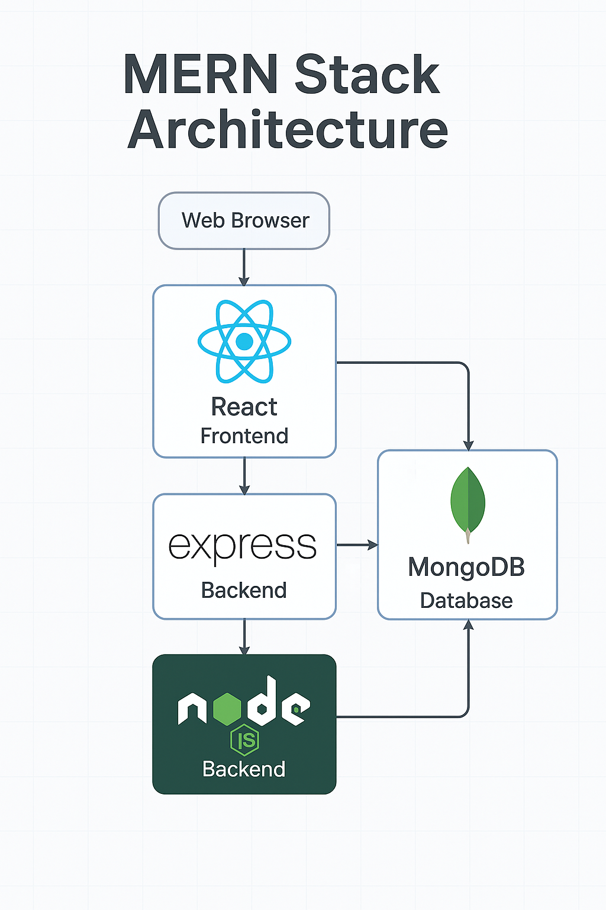
Architecture Snapshot (Before | Sprint 1 )
Notes:
💻 React (Frontend):
Handles user interface and interaction in the browser.
Communicates with the backend via HTTP requests (e.g., fetch/axios).
⚙️ Express + Node.js (Backend):
Manages routes, APIs, and business logic.
Runs on a Node.js server to process data and send responses.
🗂️ MongoDB (Database):
Stores all persistent data: user profiles, jobs, resumes, applications.
Interacts directly with the backend using Mongoose (or native driver).
🔁 Flow:
User → React → Express/Node → MongoDB → Back to User

Slide 4
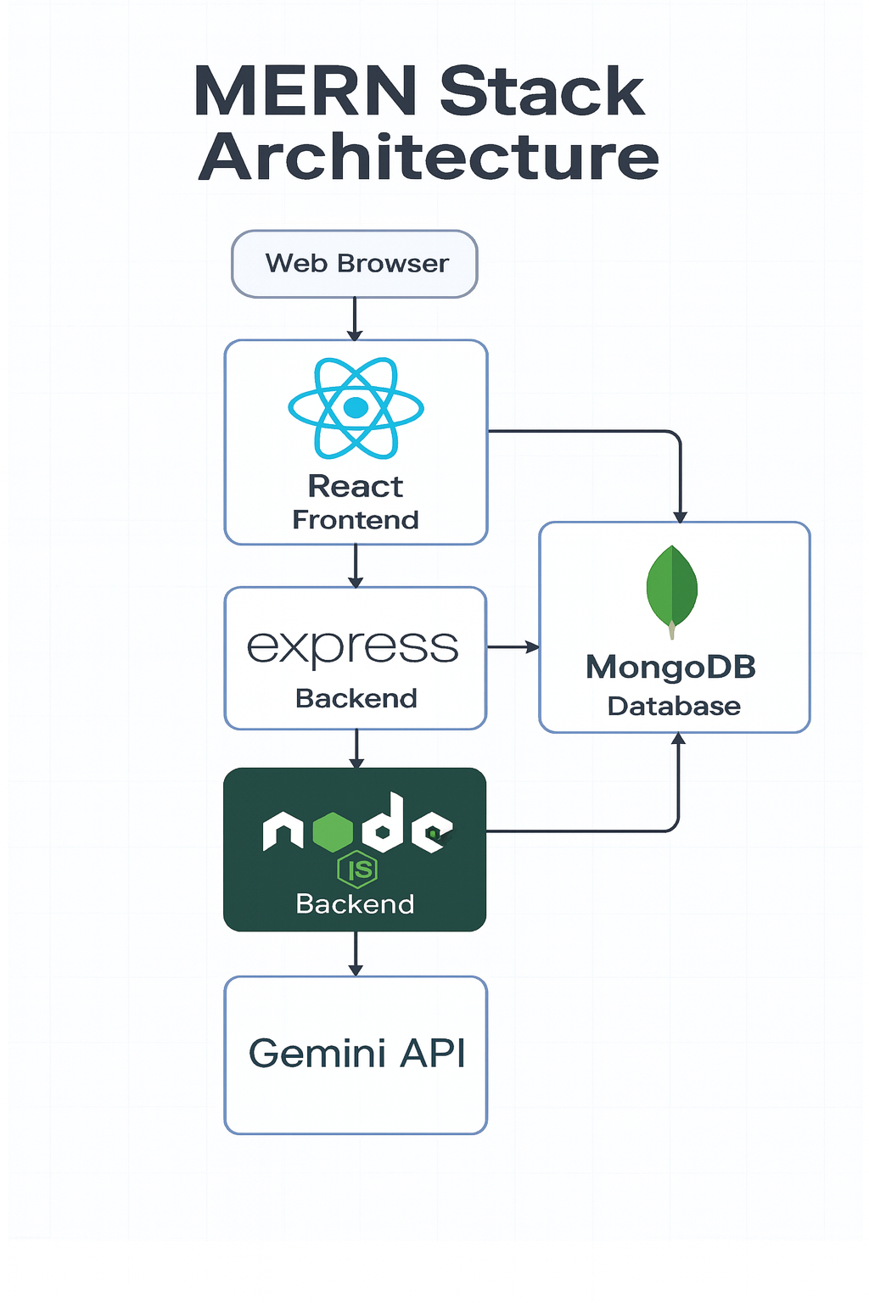
Architecture Snapshot (After | Sprint 2)
Notes:
💻 React (Frontend):
Handles user interface and interaction in the browser.
Communicates with the backend via HTTP requests (e.g., fetch/axios).
⚙️ Express + Node.js (Backend):
Manages routes, APIs, and business logic.
Connects with both MongoDB for data operations and the Gemini API for AI-powered insights.
🗂️ MongoDB (Database):
Stores all persistent data: user profiles, jobs, resumes, applications.
Interacts directly with the backend using Mongoose (or native driver).
Gemini API (AI Integration):
Provides intelligent suggestions, summaries, or recommendations based on user data.
The backend sends requests to Gemini, processes the output, and returns results to the UI.
🔁 Flow:
User → React → Express/Node → MongoDB & Gemini API → Back to User

Slide 5
Links to Demo/Github
Github

Slide 6
Thanks!

